Slide 1


E-Commerce Recommendation System with Flask and Machine Learning

Slide 2

Presented by:
Sujith.A [2022115312]
Shanjai.K [2022115311]
Narmatan.A [2022115318]

Slide 3

Introduction

Slide 4

Growth of e-commerce and the challenge of choice overload for users. Need for Recommendation Systems: How recommendations can simplify product discovery.

Slide 5
Overview of the Project
Project Aim: To create a recommendation system that suggests products based on user behavior and preferences.
Scope: Covers the end-to-end process from data collection to model deployment.
Outcome: A web-based system offering personalized product recommendations.

Slide 6
Overview of Tools and Technologies
Programming Language: Python for data analysis and machine learning.
Web Framework: Flask for building the web interface.
Machine Learning Libraries:
scikit-learn for implementing recommendation algorithms.
TensorFlow for deep learning models.
Data Handling:
NumPy and pandas for data manipulation.
Database Management: SQL or NoSQL (e.g., SQLite, MongoDB).
Deployment Platforms: Options like Heroku or AWS.

Slide 7
Advantages of Recommendation Systems
Enhanced Personalization: Tailors suggestions to individual user tastes.
Increased User Engagement: Keeps users on the platform longer by offering relevant products.
Higher Conversion Rates: Recommending products that match user needs increases sales.
Customer Retention: Builds loyalty by consistently delivering valuable suggestions.
Inventory Management: Insights into user trends help optimize stock based on demand.
Competitive Edge: Creates a more engaging shopping experience, differentiating from competitors.

Slide 8
Understanding Recommendation Systems
Definition:
Algorithms that predict user preferences to suggest items
Types:
Content-based Recommendations.
Collaborative Filtering.
Hybrid Approaches.
Multi-model Recommendations.

Slide 9

Content-Based Recommendation Systems
Overview:
Analyzes item attributes and user preferences to recommend similar items.
How It Works: Uses product descriptions, tags, and user profiles.
Example: Suggesting similar products to those previously viewed or purchased.

Slide 10
Collaborative Filtering
Overview:
Based on user behavior data like ratings and purchase history.
Types:
User-based: Finds similar users.
Item-based: Finds items similar to those the user has liked.
Techniques:
Matrix Factorization (e.g., SVD).
Neighborhood-based methods (e.g., KNN).

Slide 11
Hybrid Recommendation Systems
Definition: Combines content-based and collaborative filtering for better results.
Why Use Hybrid Models?: Balances the strengths of both methods.
Example: Combining item attributes and user ratings for recommendations.

Slide 12
Multi-Model Recommendation Systems
Overview: Uses multiple machine learning models to enhance recommendations.
Advantages: Captures complex patterns in user behavior.
Example: Blending neural networks with traditional algorithms

Slide 13

Building the Recommendation System
Step 1: Data Collection and Preprocessing
Product attributes, user ratings, interactions.
Step 2: Implementing Content-Based Algorithms.
Step 3: Developing Collaborative Filtering Models.
Step 4: Creating Hybrid Models for Improved Accuracy.
Step 5: Exploring Multi-Model Approaches.
Tools Used: Python libraries (NumPy, pandas, scikit-learn, TensorFlow).

Slide 14
Integrating the System with Flask
Why Flask?: Lightweight and suitable for web applications.
Features to Implement:
User registration and login.
Product browsing and search.
Dynamic recommendation display.
User Interface: Clean layout with product cards and recommendation sections.

Slide 15
Flask Application Workflow
Flowchart:
User input (ratings, interactions).
Data processing through the recommendation engine.
Flask routes handling user requests.
Recommendations displayed on the web interface.
User Feedback Loop: How user actions refine recommendations.

Slide 16
Security and User Experience
User Authentication: Managing user sessions securely.
Product Display: Images, descriptions, prices, ratings.
Interactive Features: Allow users to rate and like products, improving recommendations over time.

Slide 17
Benefits of the Recommendation System
Enhanced User Engagement: Personalized suggestions keep users engaged.
Boosted Sales: Targeted recommendations lead to higher conversion rates.
Customer Satisfaction: Helps users find products they love, increasing loyalty.

Slide 18
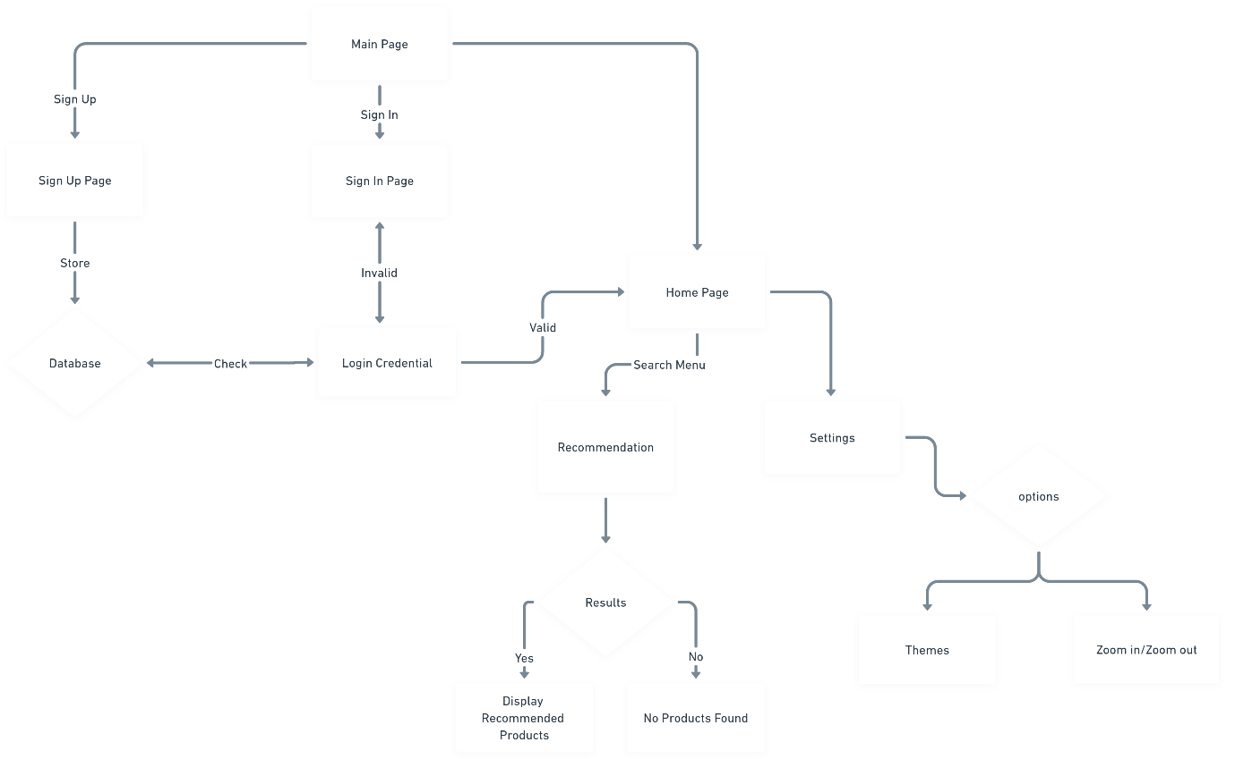
System Architecture

Slide 19
Conclusion
Summary: Key benefits of integrating a recommendation system with Flask.
Future Directions: Real-time recommendations, deep learning models.
Call to Action: Encouragement to implement and experiment with recommendation systems.

Slide 20
Thank you

